Slide 1
Influence

Slide 2
Network-Behavior Matching
Persons tend to associate with persons who engage in similar behaviors as themselves
Homophily, assortative mixing, trait clustering
Smoking, physical activity, consumption, alcohol, sleep, happiness, sex
4 Mechanisms
  Social Contagion, Influence and Imitation
  Self- Selection, Choice Homophily
  Avoidance and Withdrawal
  Endogenous Dyadic Processes, Tie Decay
  Shared Interaction Settings

Slide 3
Contagion and Influence
Adopt when others associated with you adopt
Transmission, interpersonal influence
Relatively static network with flows between nodes (pipe and flows model)
Individuals change after they start interacting
Relatively stable network, changing human behavior
Threshold models
Econometric lagged regression models
Example - Spread of Obesity

Slide 4
Contagion/Influence: Christakis & Fowler
Lagged panel data model
  Ego obesity(t+1) = f(ego attributes, ego obesity (t), alter’s obesity (t and t+1)
  alter obesity (t) controls for homophily
  influence if alter obesity (t+1) → ego obesity (t+1)
Results
  Risk of obesity 45% higher if connected to an obese alter (1-hop)
  20% higher if 2-hops from obese person, 10% for 3-hops
Confounding Factors
  Direction of friendship matters
  Increasing social distance (hops) decreases effect of alter on ego; increasing geographical distance does not
  No neighbor effects
  No simultaneous effects from contemporaneous exposure
Critique -- Stable network

Slide 5
Selection
Choice Homophily
Predict tie formation by ego-alter similarity
Network-behavior matching because people choose to associate with similar others
Interaction comes after behavioral matching
  Develop durable behavioral dispositions and then select friends based on those dispositions
Dispositions and behaviors stable, social ties changing

Slide 6
Stochastic Actor-Oriented Models (SAOM, SABM)
Simulation (agent based model) and Regression Model
Estimates simultaneously effects of factors on
  Probability of a tie (formation and decay) like ERGMs but at node not tie level
  Probability of a change in the behavior
Exogenous and endogenous factors for tie existence
Actor can either form ties, dissolve ties, or change behaviors
Partition level of clustering into selection and influence
  Selection and dissolution
Panel data, small N

Slide 7
Avoidance and Withdrawal
Network-behavior matching result of differential rates of tie decay.
Behavior leads to loss of ties (e.g. depression)
Remaining ties are more homophilous
Actions of alters lead to network-behavior matching

Slide 8
Tie Decay
Liability of newness, most ties do not last very long
What types of ties are more likely to decay? Heterophilous
Selective dissolution of ties → trait clustering
Random tie formation but differential tie decay
Dissolution often more important than formation because extent of (dis)similarity unknown prior to social interaction resulting from tie formation

Slide 9
Context
Common cause of both persons in dyad having the same property AND having a tie
Contextual effects
Social Foci: similarity and tie formation, induced homophily

Slide 10
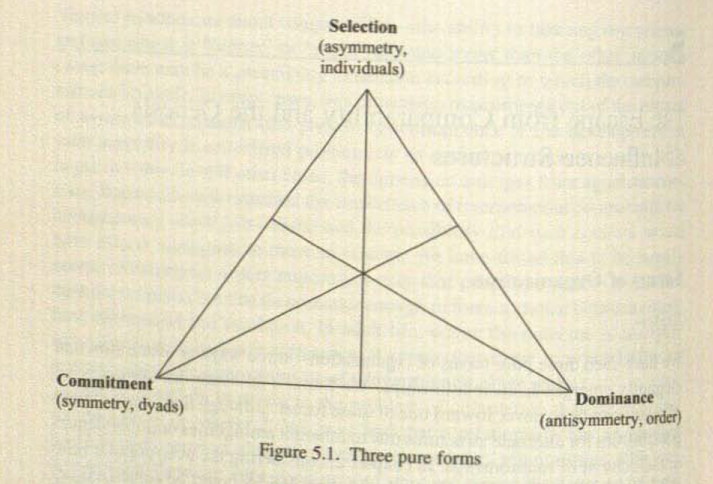
Martin: Social Influence (Chapter 5)
Selection
  preferential attachment
  popularity tournament
Commitment
  e.g. marriage
  reciprocity
Dominance
  pecking order
  hierarchy
  social influence
PA is not dominance

Slide 11
Social Influence
In what network structures are we more likely to see influence?
When is influence more likely to occur?
What do we mean by influence? What situations are “influence” situations?
Martin -- assemble social structures from network components

Slide 12

Diffusion or Contagion?
k = probability of adopting independently
y = proportion who have not adopted
Diffusion:
  Equal probability (k) of adopting in each time period and for each person
  not a function of exposure (p)
Contagion:
  Equal probability of adopting (k) but also adoption a function of number of others who have adopted.
  Global thresholds
  Local network thresholds

Slide 13
Forms of Diffusion
Diffusion without a network, uniform probability of adopt.
Diffusion without a network, varying probability of adopt. Global Threshold Model
Diffusion with a network, adopt if exposed. Disease Model
Diffusion with a network, thresholds (resistance). Influence Model
  Credibility → mutuality and cliques
  Authority → command trees

Slide 14
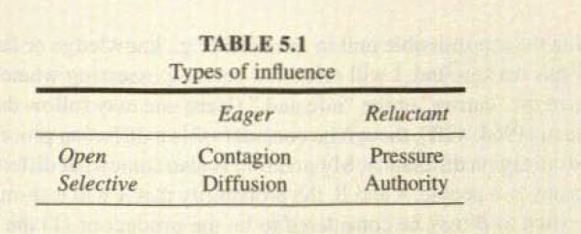
Types of Influence
Contagion: not specific, no resistance (diffusion without contagion)
Pressure: not specific, resistance (diffusion without a network)
  Global threshold model: resist until enough others "infect" you
  critical mass
  S Shaped curve
  Roger’s model
Diffusion: specific, no resistance (diffusion with a network, what I call contagion)
  p-differential: probability of contact
  but whatever increases probability of contact could be the cause of similarity
  spurious diffusion
  asymmetry --> q-differential
dx/dt = pqx(N-x)
X - number of carriers p - probability A- B tie
N - number of persons q - probability of transmission A → B
Notes:
Contagion == each time interval x% convert, diffusion not a function of thresholds, everyone exposed, open and eager
Pressure == everyone exposed, but thresholds
Diffusions == network, contact sufficient p-differential
Authority == network, thresholds

Slide 15
Authority
q-differential: probability of transmission
  Contact (exposure) not sufficient because resistance
credibility vs. authority
  credibility --> mutuality, cliques
  authority --> command trees
dx/dt = pqx(N-x)
X - number of carriers p - probability A- B tie
N - number of persons q - probability of transmission A → B

Slide 16
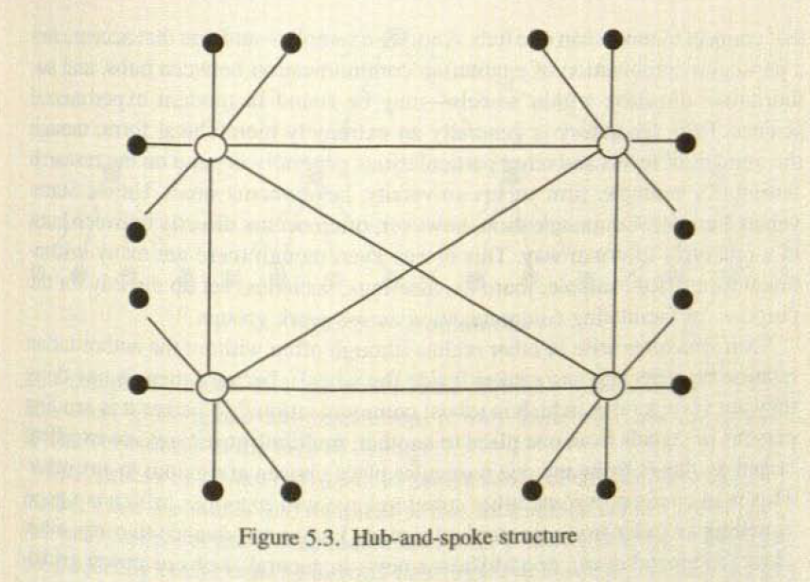
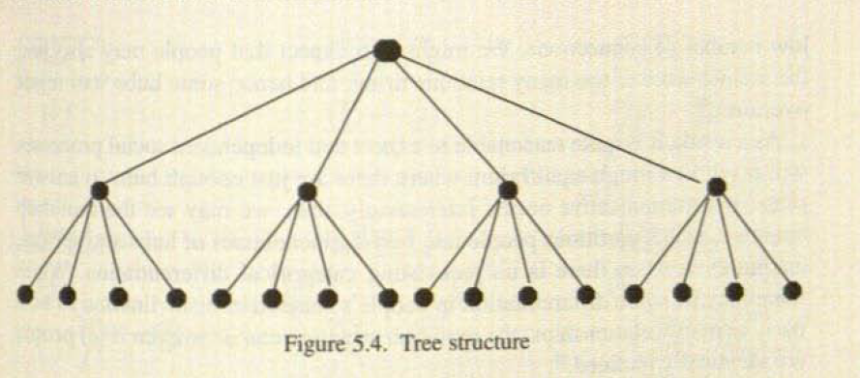
Hierarchy Forms
q-differential - credibility --> cliques
  in-group / out-group
PA --> status hierarchy, amplification, deference
  center-periphery
q-differential - authority --> command trees
  specific starting place diffusion
  pecking order (caged system) ?? emergent??
  always accept influence from those higher in status

Slide 17
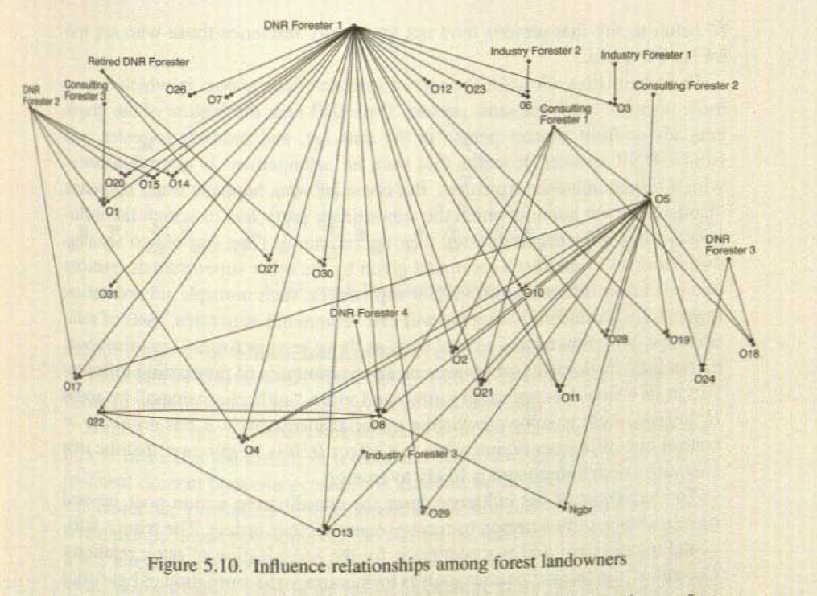
Trisets
Never accept influence from someone lower than you
  all arrows go down
Can reject influence
Tendency not to directly influence someone who is far below you (mediation)
Multiple influencers
Coordination????

